Slide 1

SOEN 6441 Advanced Programming Practices
RISK
Presented by:
Team W13
Rohit 40268994
Raghav 40276920
Ishaan 40262194
Sumit 40254093
Kevin 27035047
Bhavya 40270772

Slide 2
Goal of Build 2
Objective Statement:
"The goal of Build 2 was to create a fully operational system that effectively addresses project-specific challenges and implements essential system features, while also incorporating numerous enhancements.“
Accomplishments:
"Implemented State and Command design patterns to enhance system functionality."
"Enabled users to receive informative feedback on invalid commands and options."
"Developed a functional map editor and a game log system using the Observer pattern."
"Applied the Command pattern to handle game orders efficiently."
"Introduced a card system for Players, enhancing gameplay dynamics."
"Refactored the codebase, improving overall code quality and maintainability."
"Achieved extensive unit testing coverage, including map validation, order execution, and end-game scenarios."
"Established a well-populated version control history with over 50 commits."
"Maintained comprehensive API documentation for all files, classes, and methods."
"Adhered to coding conventions, ensuring consistency throughout the project."
"Organized the project structure with separate folders for modules, including test classes that mirror the code structure."

Slide 3
Table Of Contents
Architecture Overview and Diagram
Functional Description
Game snapshots
Coding Convention followed
Challenges and Future Developments
Tools used
JUnit

Slide 4
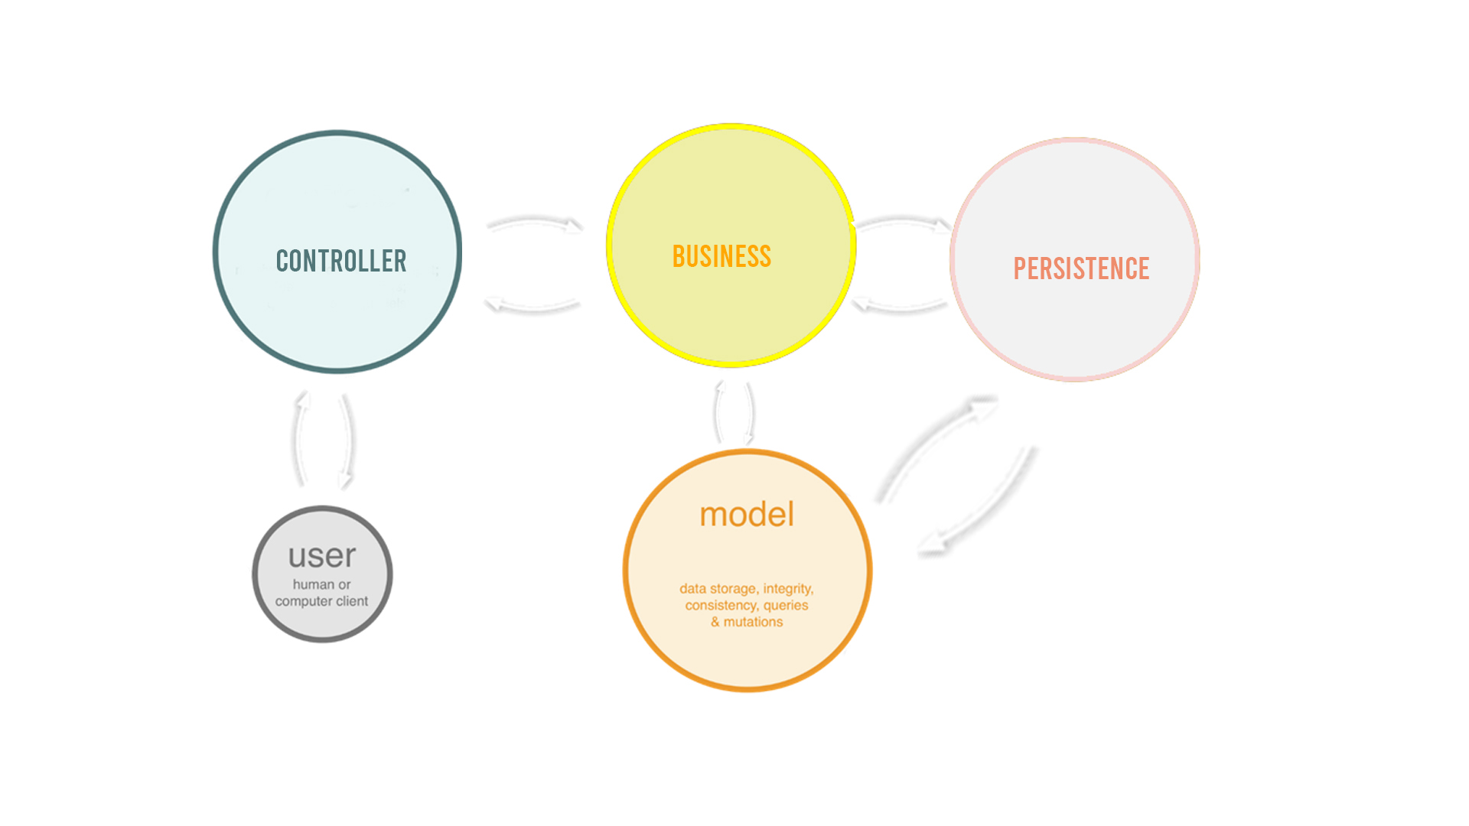
Architectural Style
VIEW MODULE
This module is responsible for interacting with user and executing commands. It also contains the observer class from observer pattern.
CONTROLLER MODULE
This module is responsible for processing commands, game rule etc. It also implements the state pattern for phases and adapter pattern for maps.
MODEL MODULE
This module is used for storing data objects like Player, Countries etc. It contains the observable class from observer pattern. It also implements the strategy pattern and command pattern.

Slide 5
VIEW MODULE
This module is responsible for interacting with user and executing commands. It also contains the observer class from observer pattern.
CONTROLLER MODULE
This module is responsible for processing commands, game rule etc. It also implements the state pattern for phases and adapter pattern for maps.
MODEL MODULE
This module is used for storing data objects like Player, Countries etc. It contains the observable class from observer pattern. It also implements the strategy pattern and command pattern.

Slide 6
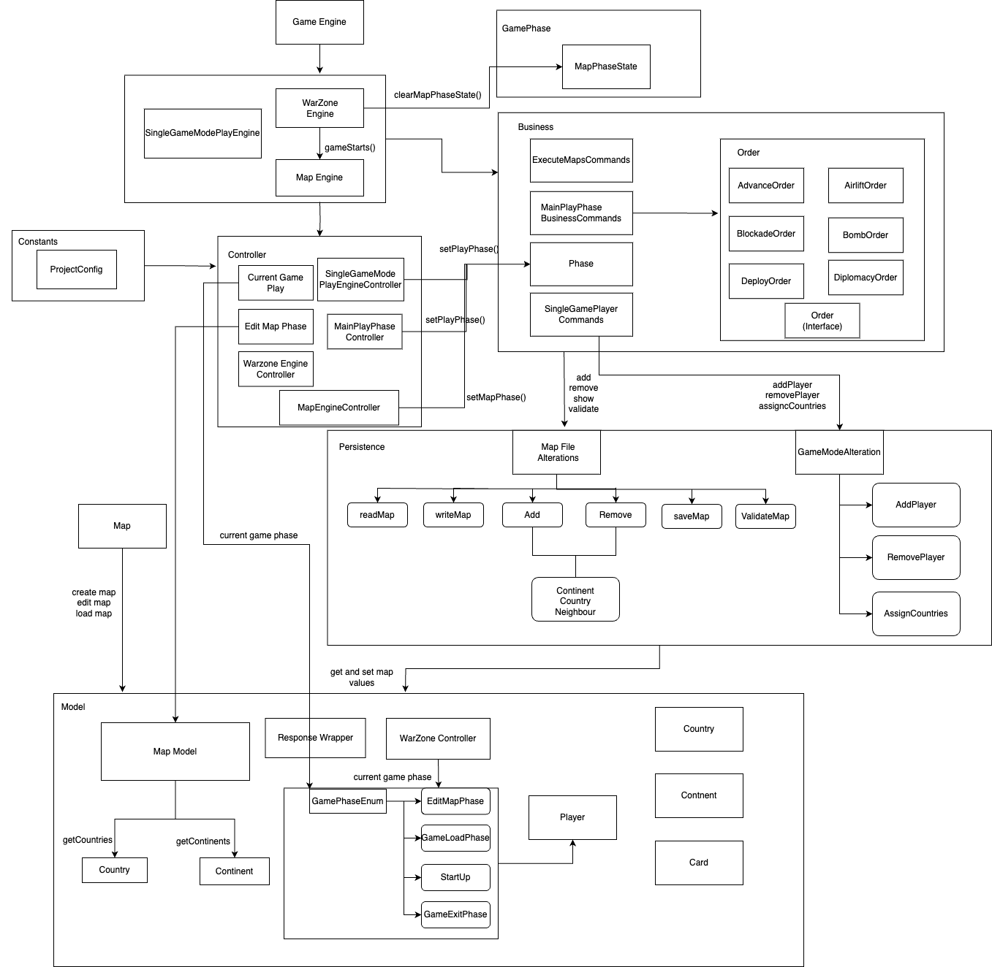
Architecture Overview

Slide 7
Functional Description
In Build 2 of our project, we've introduced significant enhancements and new features to elevate the gaming experience. Let's explore the key functional aspects of this build
Game Log File and Observer Pattern
Order Creation and Execution
Command Pattern for Orders
Player Cards and Game Play Commands
Refactoring Using the State Pattern & Singleton Pattern
CI/CD Integration

Slide 8
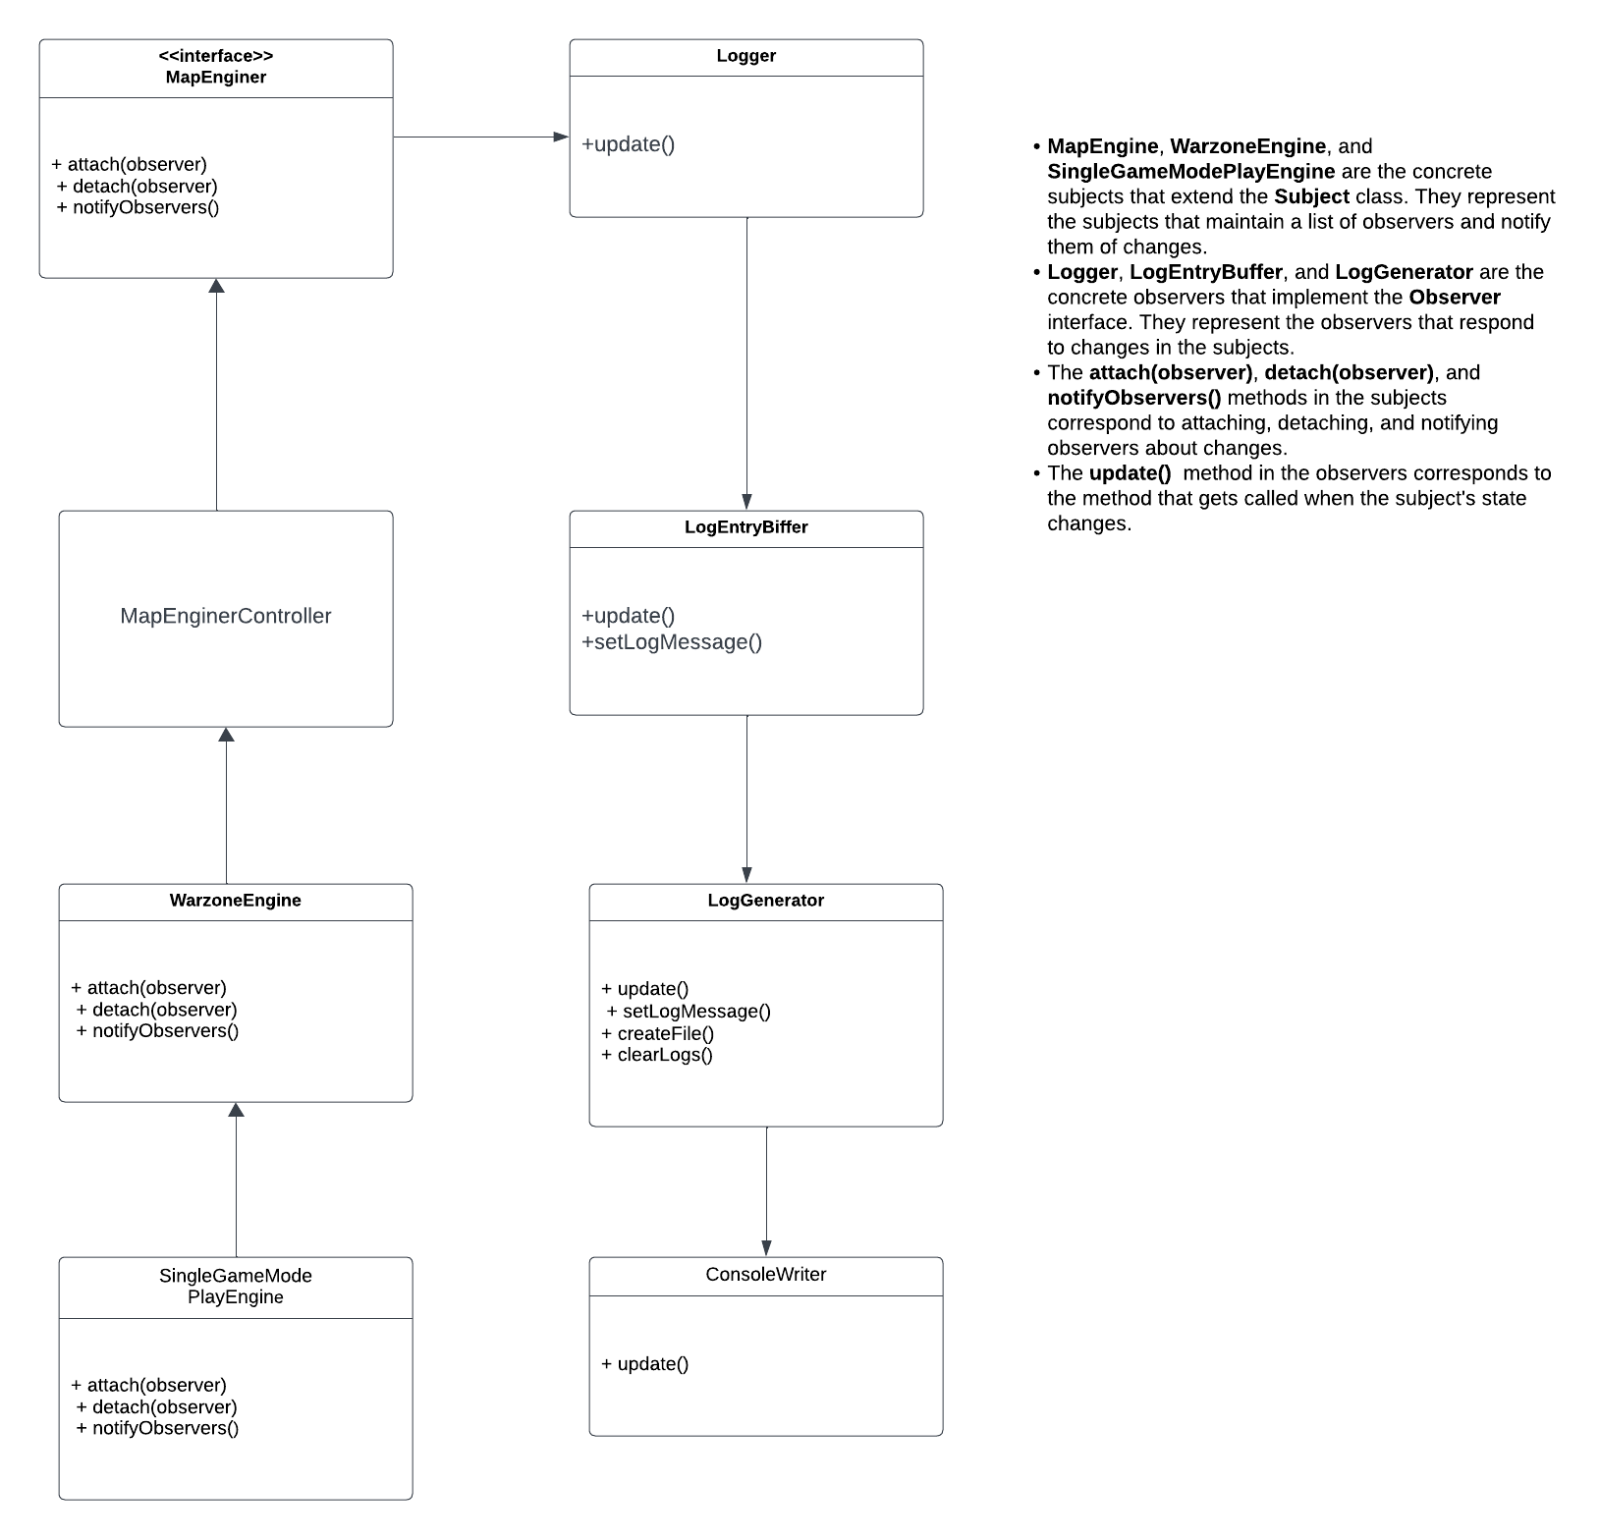
Game Log File and Observer Pattern
In the latest update, we've introduced two vital enhancements to our game architecture: the Game Log File and the Observer Pattern. These improvements bring clarity and real-time insights to our gaming experience.
Game Log File:
We've established a dedicated Game Log File to record game-related events.
Logger Class: Manages log messages, offering control and consistency.
LogEntryBuffer Class: Formats and stores log entries for easy reference.
Observer Pattern:
We've implemented the Observer Pattern to provide real-time updates.
Observers (e.g., ConsoleWriter, LogGenerator) track and display log entries.
Immediate insights into game events, enhancing debug and analysis.

Slide 9
Game Log File and Observer Pattern
Key Benefits:
Game Log File ensures a comprehensive, organized record of game events.
Observer Pattern delivers real-time insights into game state and events.
Facilitates debugging and in-game analysis, improving gameplay.
Results:
Enhanced game monitoring and debugging.
A more robust foundation for future feature development.
Improved gameplay experience for players.
These additions bolster the transparency and functionality of our game system, ensuring that every move and event is well-documented and easily accessible.

Slide 10
Order Creation and Execution
In Build 2, we've honed the art of strategic command and execution, elevating the gaming experience. Let's delve into the specific elements that make this aspect shine:
Order Creation:
Deploy Order: Strategically deploy armies to a country.
Advance Order: Move armies between countries and engage in strategic maneuvers.
Bomb Order (requires bomb card): Launch destructive attacks on specific countries.
Blockade Order (requires blockade card): Isolate countries to disrupt your opponents.
Airlift Order (requires the airlift card): Swiftly transport armies between countries.
Diplomacy Order (requires diplomacy card): Forge alliances and negotiate with other players.
Each order type has unique conditions and prerequisites for execution.
Order Execution:
Seamlessly execute orders with precision.
Real-time monitoring of game progression during the Order Execution Phase.
The GameEngine prompts each player for their next order using the next_order() method and executes orders using the execute() method of the Order class.

Slide 11
Command Pattern for Orders
In Build 2, we've implemented a robust command pattern to streamline the execution of orders, enhancing the gameplay experience. Let's explore the key components of this feature:
Command Pattern:
The Command class represents different types of orders, such as Deploy, Advance, Bomb, Blockade, Airlift, and Diplomacy Orders.
The Invoker Class is embodied by the Player, responsible for creating orders.
The Client Class is the GameEngine, which processes and executes these orders.
This pattern allows for the creation, queuing, and execution of various orders seamlessly, providing a structured and efficient approach to managing gameplay.
This feature offers players an organized and straightforward way to issue orders, with the added benefit of scalability to accommodate future order types, making it a pivotal part of our game's architecture.

Slide 12
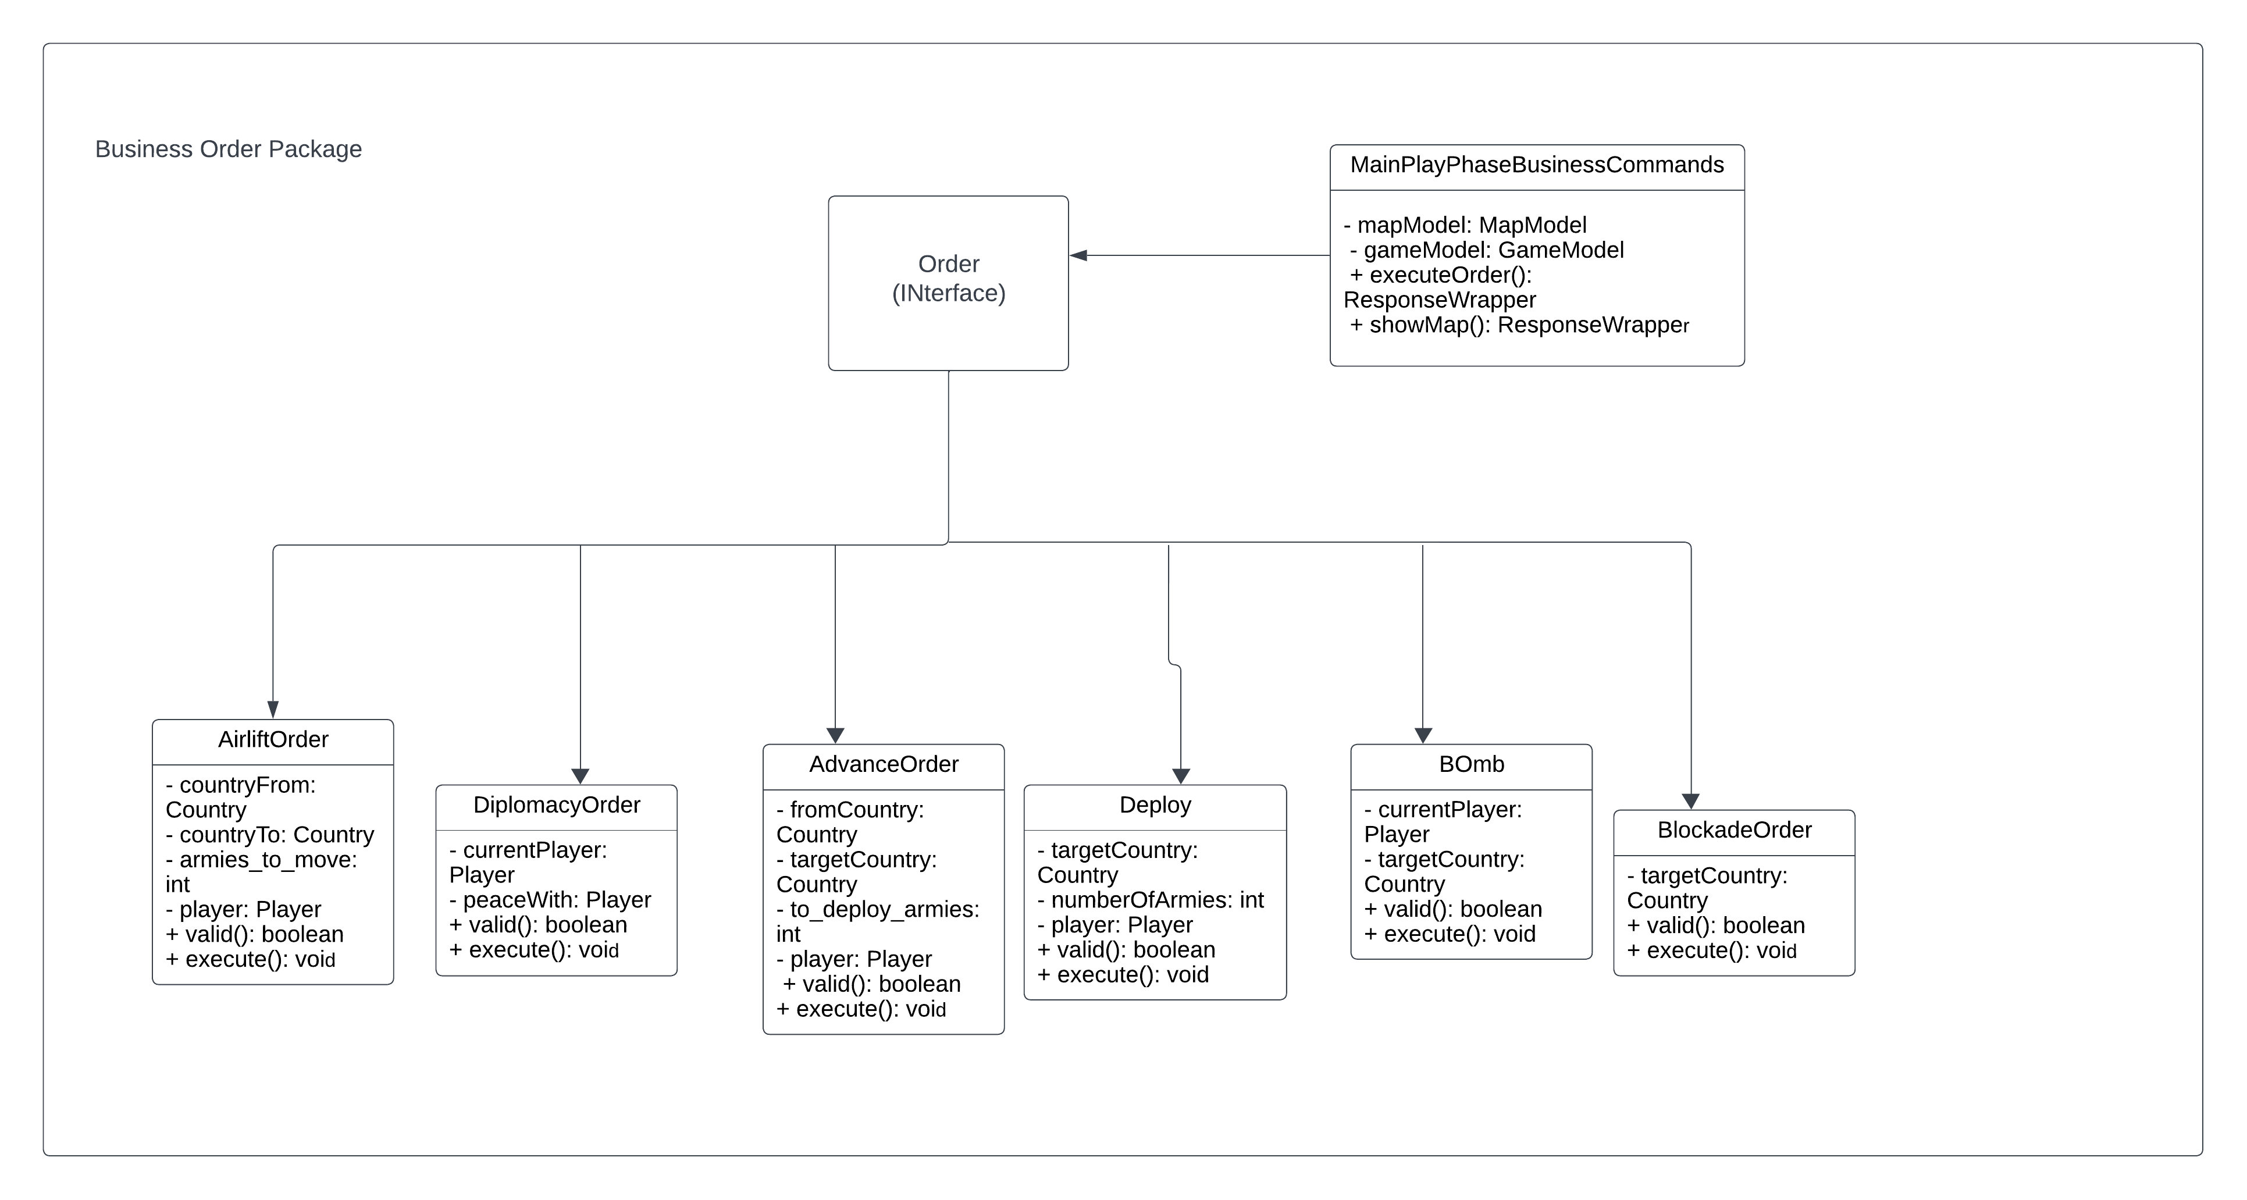

Slide 13
Player Cards and Game Play Commands
In Build 2, we've introduced player cards and game play commands to enhance strategy and variety in gameplay.
Player Cards:
Every player now has access to a set of strategic cards.
Players start with no cards but can accumulate them during gameplay.
Cards can be used strategically to influence game dynamics.
Game Play Commands:
Game play commands include actions like showing the game map and game startup phase.
These commands initiate crucial phases of the game.
Players can strategically use cards and issue commands, adding depth and diversity to the gameplay.

Slide 14
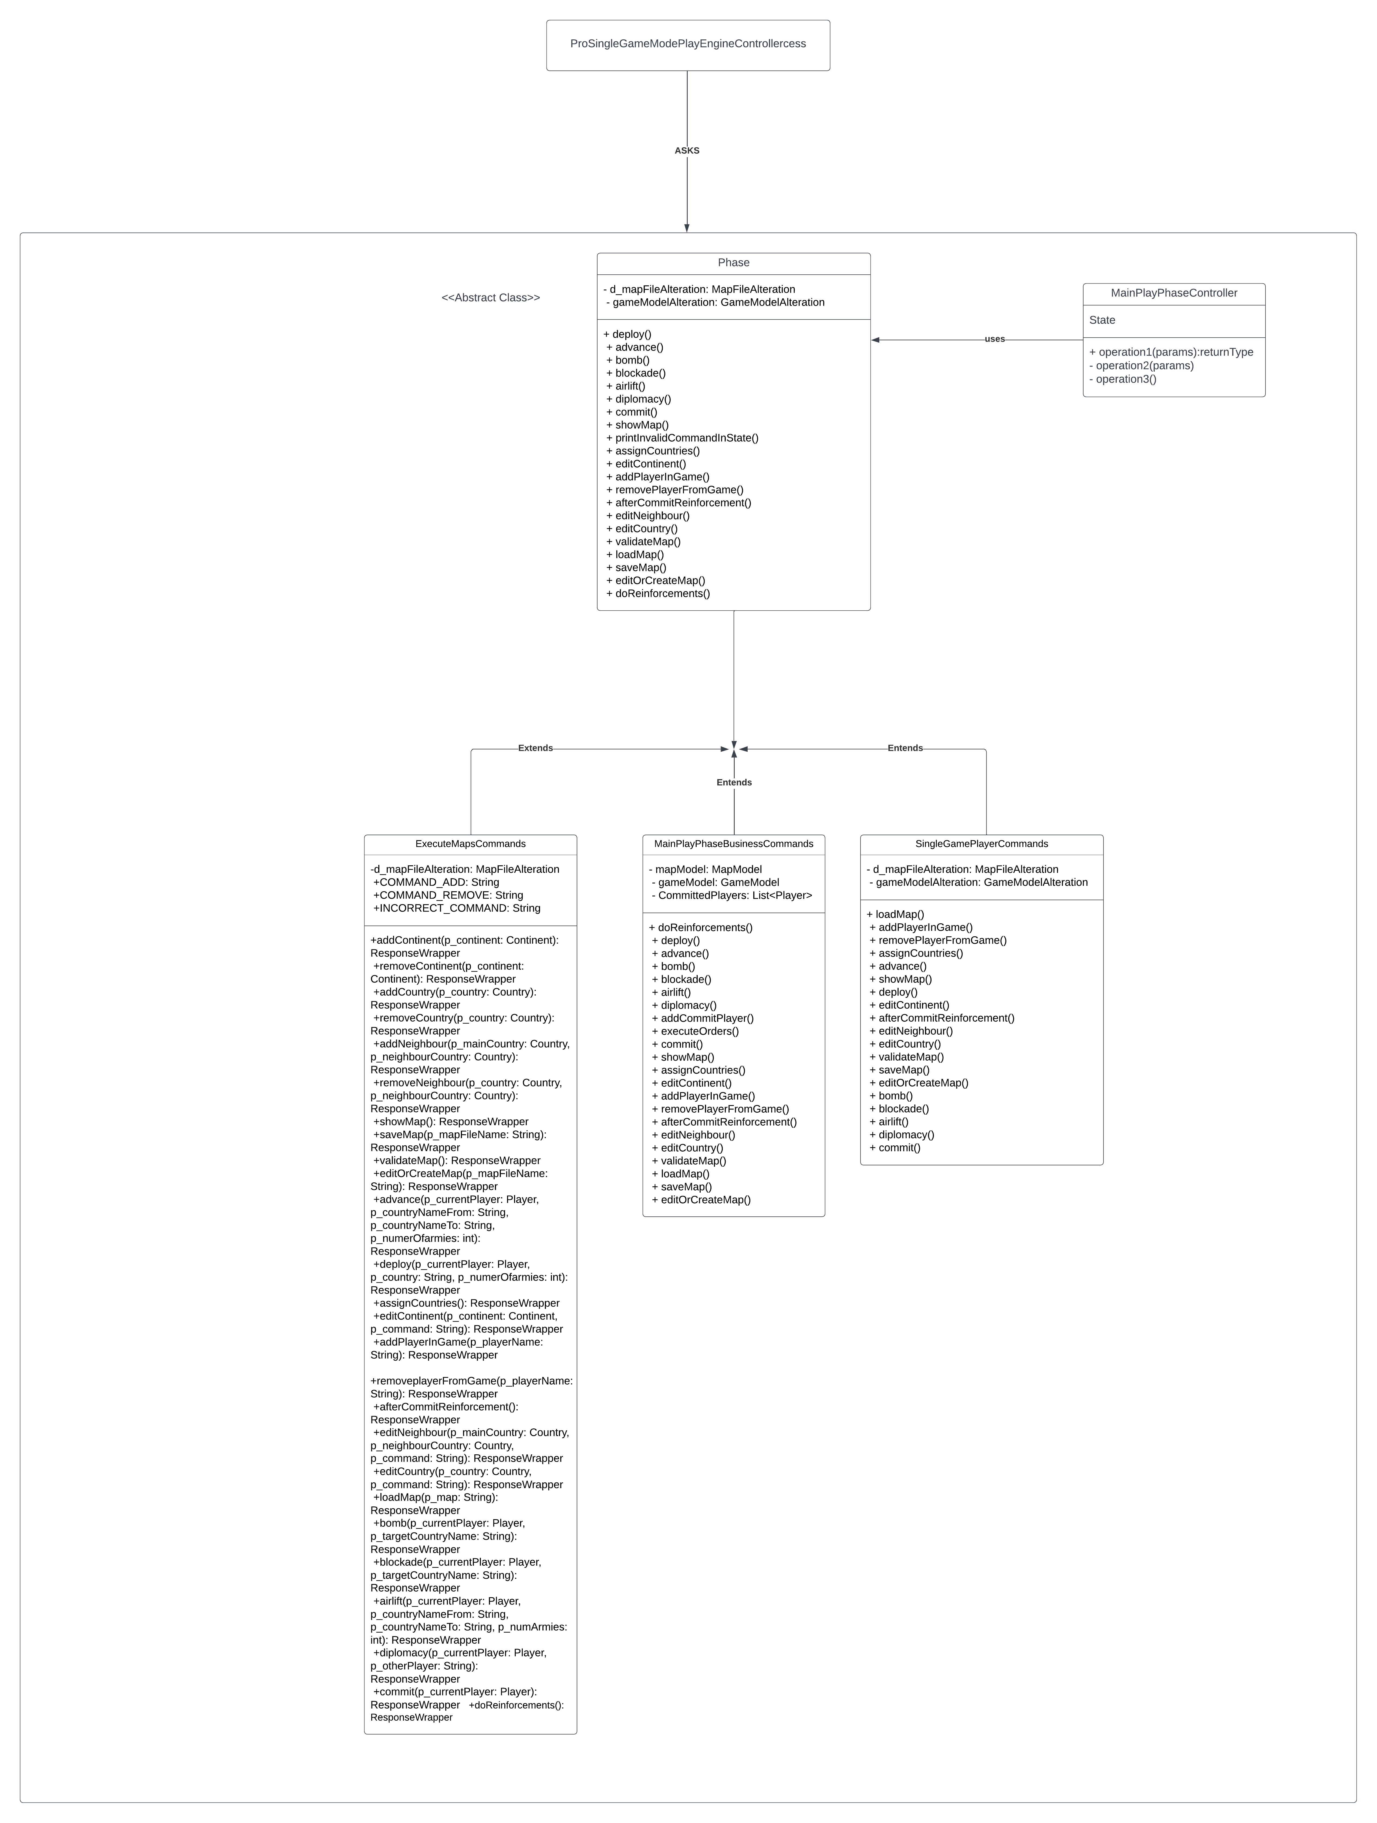
Refactoring Using the State Pattern
In Build 2, we've undertaken a significant refactor of our game architecture, introducing the State Pattern to elevate our game state management. Let's delve into this transformation:
What is the State Pattern?
A design pattern that simplifies the management of game states.
Encapsulates each state (e.g., map editing, gameplay) into distinct classes.
Transitions between states smoothly, improving code structure.
Implementation Details:
MapPhaseState: Handles map editing tasks, ensuring correctness.
GameplayPhaseState: Manages gameplay, order execution, and more.
OrderExecutionPhaseState: Enhances order execution efficiency.
Simplified Code: Reduced complexity, making code more maintainable.

Slide 15
Refactoring Using the State Pattern
Benefits:
Enhanced modularity for easy expansion.
Clean separation of concerns, simplifying code.
Improved maintainability and scalability.
Results:
Smoother transitions between game phases.
Cleaner, more organized codebase.
Ready for future feature integration.
This refactor brings clarity to our game architecture, streamlining state management and paving the way for a more dynamic gaming experience

Slide 16
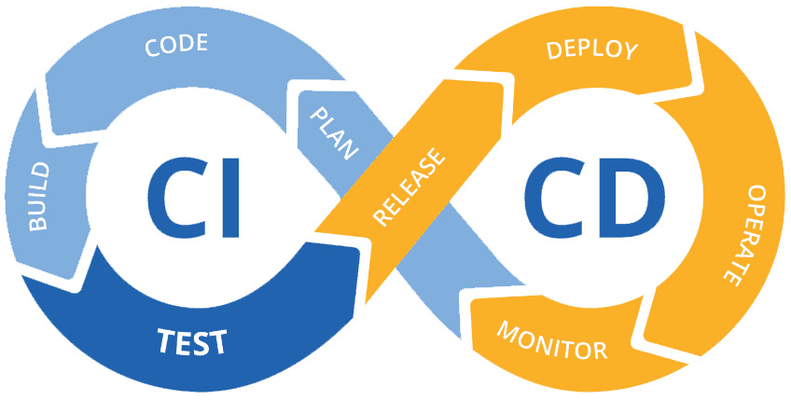
CI/CD Integration & DocLint
In Build 2, we've incorporated CI/CD integration and DocLint to streamline development and ensure robust code quality and documentation. Let's delve into the key components of these enhancements:
Continuous Integration/Continuous Deployment (CI/CD) Integration:
- CI/CD Workflow: We've established a seamless CI/CD workflow that automates code testing, integration, and deployment processes. This ensures that our application is always in a deployable state.
- Automated Testing: Every code change triggers automated tests, including unit tests, integration tests, and validation checks, to identify and rectify issues early in the development cycle.
- Version Control: Our software versioning repository now features a well-populated history with over 50 commits, evenly distributed among team members. Tagged versions for both Build 1 and Build 2 enable tracking and stability.
- Continuous Integration: Our CI solution validates that code successfully compiles, all unit tests pass, and javadoc is complete before merging into the main branch.
- Continuous Deployment: After a successful CI build, the code is automatically deployed to the target environment, ensuring rapid and reliable delivery.

Slide 17
CI/CD Integration & DocLint
DocLint for Comprehensive Documentation:
Complete Documentation: We've employed DocLint to ensure that all files, classes, methods, and even private members are thoroughly documented, adhering to industry best practices.
Testing Documentation: Our test classes and test cases are also meticulously documented, enhancing the understandability of our testing strategy.
Java Command Line Option: We use the java command line option -Xdoclint to validate that our Javadoc is complete and accurate.
These enhancements not only bolster code quality but also make our project more accessible and maintainable, fostering a collaborative and efficient development environment.

Slide 18
Test Cases
In Build 2, we've implemented a total of 30 test cases to ensure code quality and reliability. Here are some of the most important test cases that address critical aspects of our application:
Map Validation:
- Map Connectivity Test: Ensures that all countries and continents are correctly connected, preventing isolated territories.
- Continent Connectivity: Validates that continents are internally connected, maintaining their graph structure.
Reading an Invalid Map File:
- Invalid Format Handling: Verifies that our system gracefully handles map files with incorrect formats or missing data, effectively preventing potential crashes.
Validation of a Correct Startup Phase:
- Phase Initialization: Confirms that our game correctly enters the startup phase, allowing players to add or remove entities as intended.
Calculation of Number of Reinforcement Armies:
- Reinforcement Army Calculation: Tests the accurate calculation of reinforcement armies based on game rules and player performance, ensuring fair and balanced gameplay.

Slide 19
Test Cases
Order Validation Upon Execution:
- Source and Target Validation: Ensures that source and target validation for each order type is functioning correctly, preventing illegal moves during the game.
- Conquering a Country: Simulates conquering a country and verifies the appropriate update of the conquered country's army count.
- Moving Armies in Conquered Country: Validates the movement of armies within a conquered country, adhering to game rules.
- End of Game Scenario: Tests the game-ending condition, ensuring the game concludes accurately when all countries have been conquered.
Conclusion:
These test cases represent a portion of our comprehensive testing suite consisting of 30 tests in Build 2. They are instrumental in ensuring the quality and reliability of our application while also guaranteeing a delightful user experience.

Slide 20
Game Snapshots

Slide 21
Tools used
GitHub
Version control and collaboration
Repository setup and cloning
Collaboration with team members
Git commands for branching, committing, and pushing
Eclipse IDE
Integrated Development Environment
Project setup and coding
Running JUnit tests
Debugging and Git integration
Javadoc
Code documentation with comments
Generating Javadoc in Eclipse
Clear code documentation for classes and methods
JUnit
Unit testing framework
Writing test classes with annotations
Running tests and using assertions
Maven
Build Automation tool.
Manages projects dependencies and build processes using a pom.xml file.

Slide 22
Coding conventions followed
Naming Conventions:
- Use CamelCase for class names, starting with a capital letter.
- Prefix data members with "d_."
- Prefix method parameters with "p_."
- Prefix local variables with "l_."
- Global variables in all capital letters.
- Static members start with a capital letter, while non-static members start with a lowercase letter.
Code Layout:
- Maintain consistent code layout throughout the project by using an IDE auto-formatter.
Commenting Convention:
- Utilize Javadoc comments for every class and method.
- Document long methods (exceeding 10 lines) with comments outlining procedural steps.
- Avoid leaving commented-out code in the project.
Project Structure:
- Organize the project with one folder for each module according to the high-level design.
- Keep test code in a separate folder mirroring the structure of the main code folder.
- Maintain a one-to-one relationship between tested classes and their corresponding test classes.

Slide 23

Thank you

